Slide 1
Linear Regression
NRES 776
Instructor: Heather Bryan
Oct 14, 2021

Slide 2

Correlation vs. Causation
Oded Rechavi Twitter Feed

Slide 3
Learning Objectives
Discuss the differences between correlation and linear regression
Describe how to find the best fit line using least squares
Calculate estimates of uncertainty in the regression line
Test Hypotheses about a slope
Check assumptions of linear regression
Deal with violations of assumptions and non-linearity

Slide 4
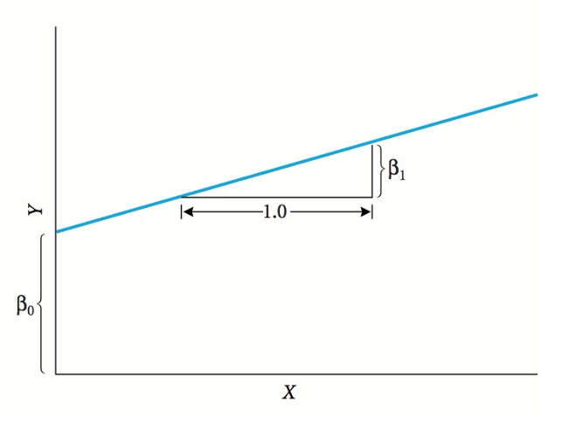

Simple Linear Regression
$$y= β_{0}+β_{1}x$$
Notes:
Simple linear regression involves 2 variables
Draw a straight line through the data to predict the response variable
Do that by estimating the slope, which is the change in the Y variable for every unit change in the X variable

Slide 5
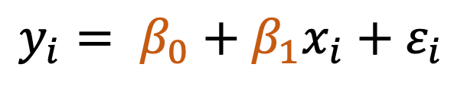
Simple Linear Regression Model
slope
error
response
variable
$$y_{i}= β_{0}+β_{1}x_{i}+ε_{i}$$
intercept
predictor
or
explanatory
variable

Slide 6

Linear Regression Example: Lion’s Nose

Slide 7
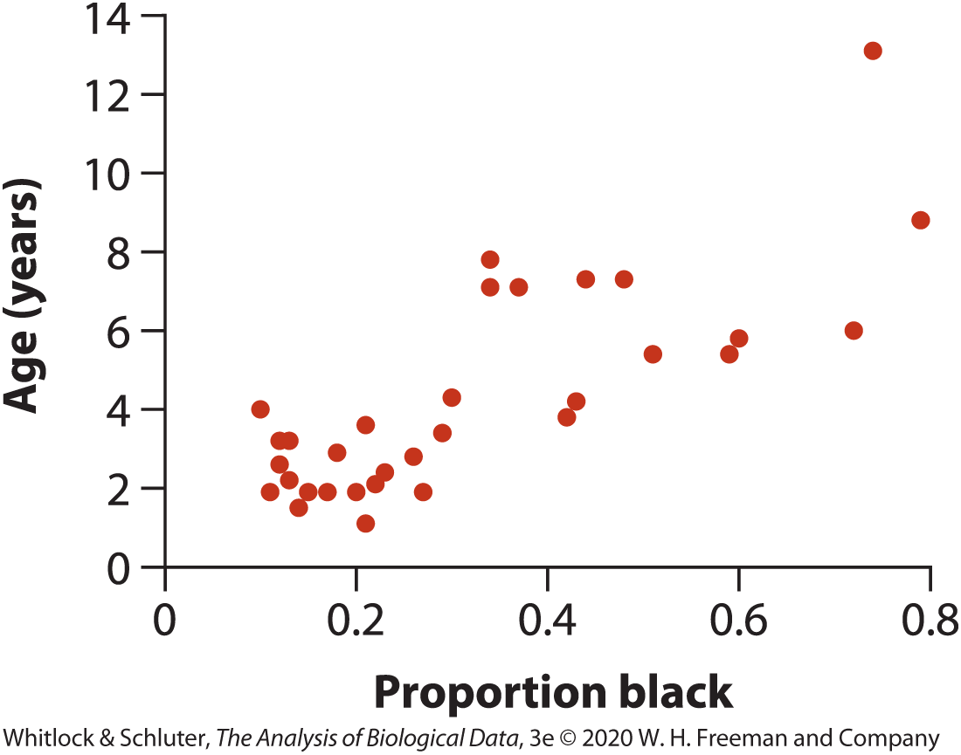
Linear Regression Example: Lion’s Nose

Slide 8
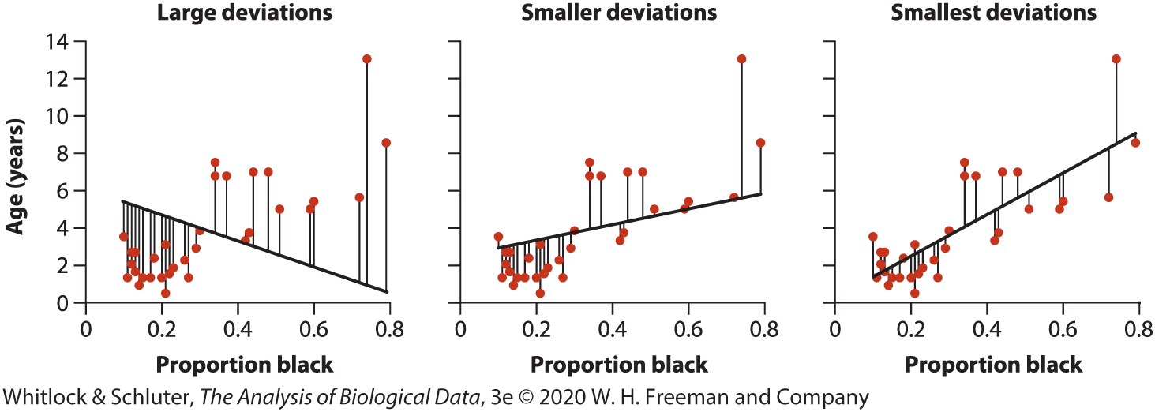

Least Squares Method for Finding the Best Fit
$$×$$
Notes:
Rotate the line through a center point representing the mean of x and y until we arrive at the best fit position

Slide 9


Calculating Slope and Intercept
Intercept (a) is the value Y is predicted to take if X=0

Slide 10
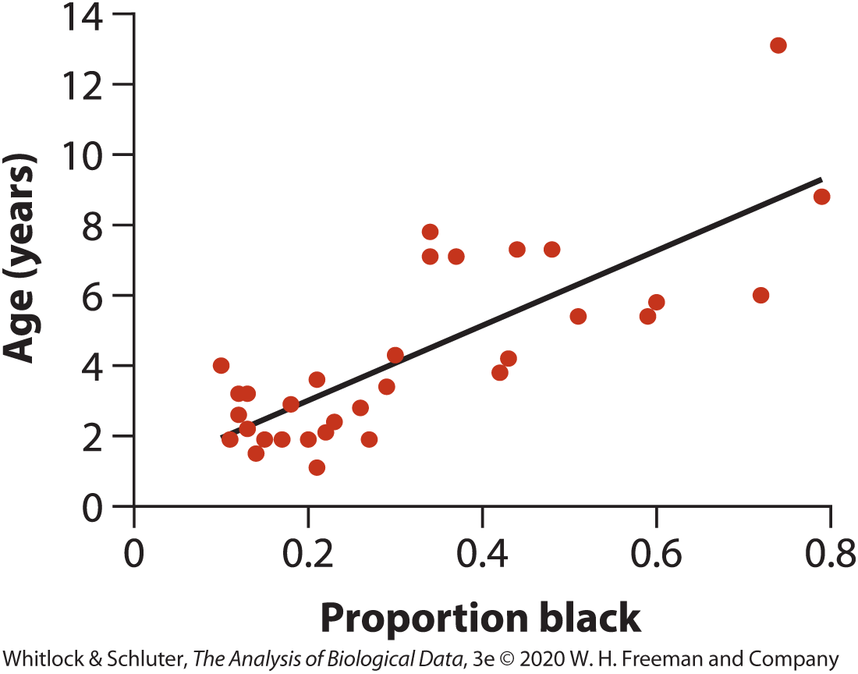

Example: regression line for lion data
$$\hat{y}=0.879+10.647x$$
Notes:
Slope of the line indicates that on average, lion age increases by 10.65 years for every unit change in the proportion of the nose that is black (or 1.06 years for every 0.1 increase in black)
Once you have the equation, can use it for predicting the value of Y (in years) for a given proportion of black on the nose

Slide 11




Residuals
Scatter of points above and below regression line
Important for estimating uncertainty in slope
$$SSresidual= \sum_{i}^{n}{{{(Y}_{i}−\hat{Y})}^{2}}$$
$$MSresidual= \frac{\sum_{i}^{n}{{{(Y}_{i}−\hat{Y})}^{2}}}{n−2}$$
$${(Y}_{i}−\hat{Y})$$
$${SE}_{b}= \sqrt{\frac{{MS}_{residual}}{\sum_{i}^{n}{{{(X}_{i}−\overline{X})}^{2}}}}$$
10.647 ± 1.1510

Slide 12


Confidence Interval for the Slope
$$95\%CI_{β}=b±t_{crit}SE_{b}$$
10.647-2.042(1.510) < $β$ < 10.647+2.042(1.510)
7.56< $β$ < 13.73

Slide 13
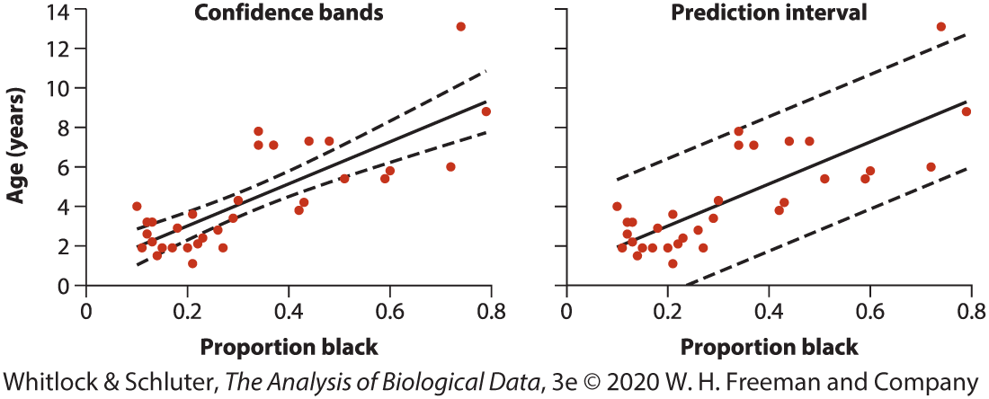
Confidence in Predictions
Confidence bands: precision of the predicted mean Y for each value of X
(What is the mean age of lions with 60% black on their noses?)
Prediction Intervals: precision of the predicted single Y-values for each X
(How old is a particular lion given that 60% of its nose is black?)
Notes:
Regression line predicts mean value of Y for any specified value of X
2 questions you might ask:
What is mean age for lions with 60% black noses?
How old is that lion, given that 60% of its nose is black?
Both questions have same mean answer (7.27 years), but differ in precision
Width of confidence bands always wider at values farther away from mean x

Slide 14
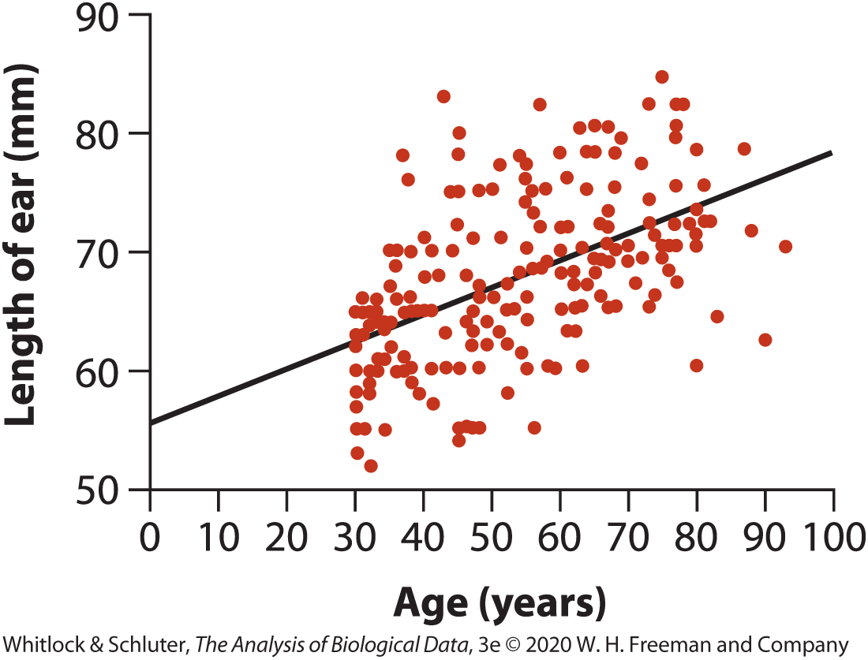
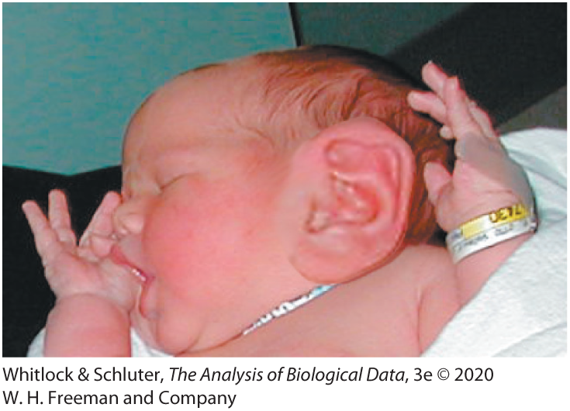
Extrapolation
Notes:
-can only predict y-values that fall within x-values of the dataset, as relationship may not be linear outside bounds

Slide 15
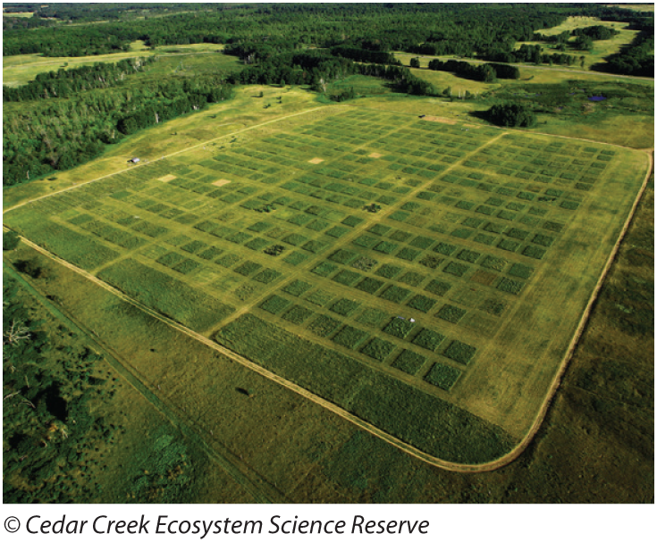
Testing Hypotheses about a Slope
Notes:
Study looked at diversity-stability relationship
How does the number of species influence ecosystem stability?
161 plots, each 9x9 m in Minnesota
Seeded plots with different numbers of species and measured biomass production over 10 years
Considered stability to be mean biomass over that time divided by the standard error of biomass

Slide 16
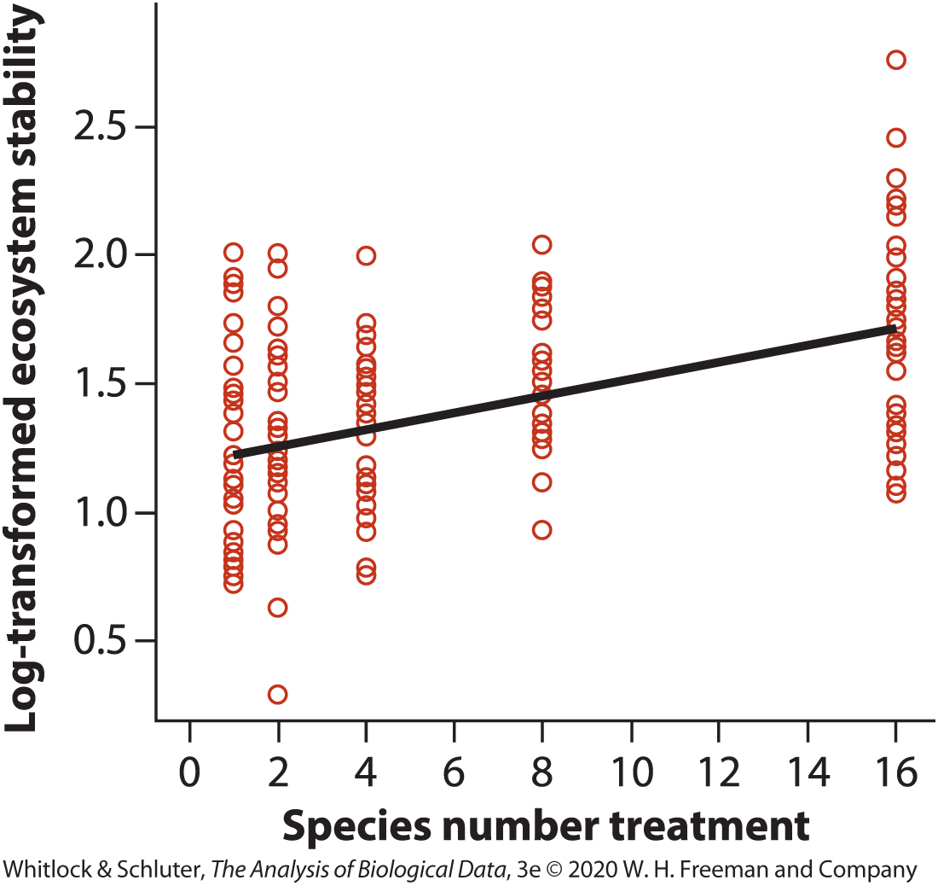

Testing Hypotheses about a Slope
H0: The slope of the regression of the log ecosystem stability on species number is zero ($β=0$)
H1: The slope of the regression of the log ecosystem stability on species number is not zero ($β≠0$)

Slide 17


Testing Hypotheses about a Slope (t-test)
H0: The slope of the regression of the log ecosystem stability on species number is zero ($β=0$)
H1: The slope of the regression of the log ecosystem stability on species number is not zero ($β≠0$)
Test Statistic:
$$t=\frac{b − β_{0}}{{SE}_{b}}$$
df: n-2
t = 6.74
$$t_{0.05\left(2\right),159}=1.97$$
P<0.05, Reject H0
Notes:
B is the estimate of the slope in the sample and SEb is the standard error of b

Slide 18



Testing Hypotheses about a Slope (ANOVA)
Source of variation | Sum of Squares | df | Mean Squares | F-ratio | p
Regression | 5.5169 | 1 | 5.5169 | 45.45 | 2.73 × 10⁻¹⁰
Residual | 19.2980 | 159 | 0.1214
Total | 24.8149 | 160
$${SS}_{regression}= \sum_{i}^{n}{{{(\hat{Y}}_{i}−\overline{Y})}^{2}}$$
$$SSresidual= \sum_{i}^{n}{{{(Y}_{i}−\hat{Y})}^{2}}$$
$$SStotal= \sum_{i}^{n}{{{(Y}_{i}−\overline{Y})}^{2}}$$
Notes:
-amount of variation in Y among individual data points with same value of X is the same as the amount of variation among data points with different X values, except by chance
-expect the Regression Mean Square to exceed the Residual Mean square if H0 is false
-Regression Mean Square is the difference between the mean y-value and the predicted y-values
-Residual Mean Square is the difference between individual y-values at a given x and the predicted y-value at that x

Slide 19

Measuring fit of the line to the data: R²
Fraction of variation in Y that is explained by X
Source of variation | Sum of Squares | df | Mean Squares | F-ratio | p
Regression | 5.5169 | 1 | 5.5169 | 45.45 | 2.73 × 10⁻¹⁰
Residual | 19.2980 | 159 | 0.1214
Total | 24.8149 | 160
$$R^{2}=\frac{{SS}_{regression}}{{SS}_{total}}= \frac{5.5169}{24.8149}=0.222$$
The number of plant species explained 22% of the variation in log-transformed ecosystem stability

Slide 20
Testing hypotheses about a slope
Consider the partially completed ANOVA table showing the results of a regression analysis shown. What is the F-ratio?
9.408
16.072
25.137
36.408
Source of variation | Sum of squares | df | Mean squares | F-ratio
Regression | 151.2 | 1 | ? | ?
Residual | 289.3 | 18 | ?
Total | 440.5 | 19

Slide 21
Testing hypotheses about a slope
Consider the partially completed ANOVA table showing the results of a regression analysis shown. What is the F-ratio?
9.408
16.072
25.137
36.408
Source of variation | Sum of squares | df | Mean squares | F-ratio
Regression | 151.2 | 1 | 151.2 | 9.408
Residual | 289.3 | 18 | 16.07
Total | 440.5 | 19

Slide 22

Linear Regression Assumptions
The relationship between $x$ and $y$ is linear
At each value of $x$, the distribution of $y$ values is normal
The variance of $y$ values is the same at all values of $x$
At each value of $x$, the $y$ values represent a random sample from the population of possible y-values

Slide 23
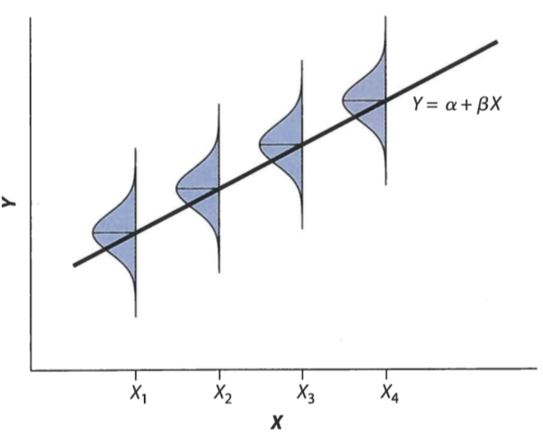
Assumptions of linear regression
Notes:
Figure shows how there is a normally distributed population of Y-values with mean on the regression line
Same variance in each of the y-populations

Slide 24
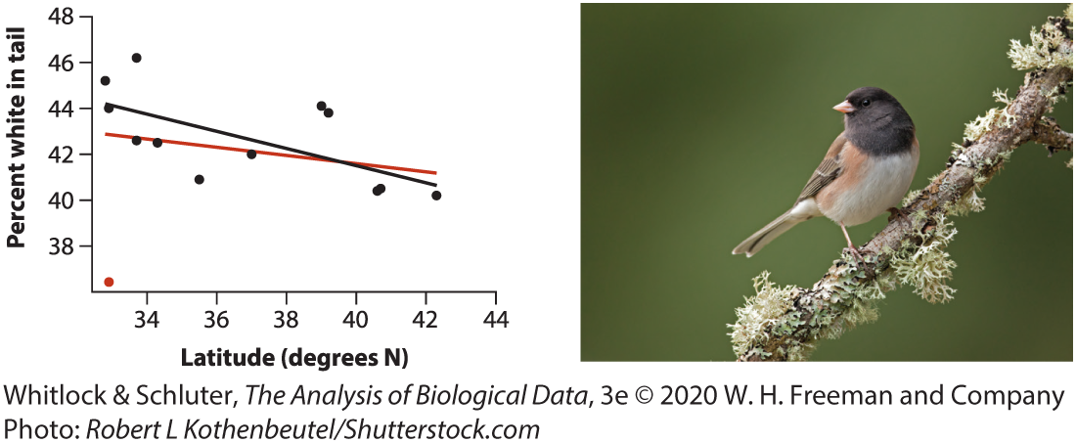
Outliers

Slide 25
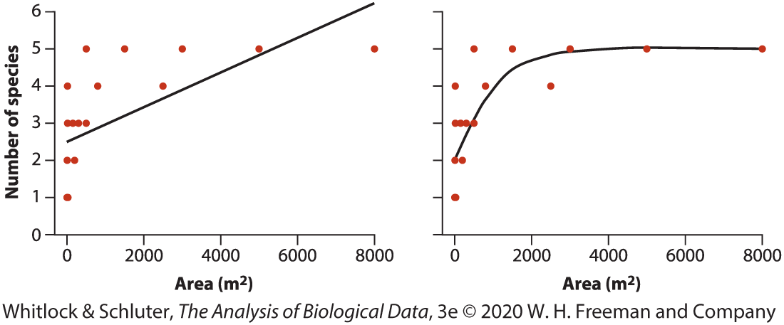
Detecting Nonlinearity

Slide 26
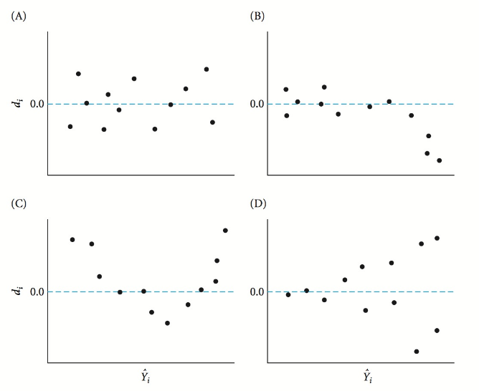
Detecting non-normality and unequal variance: Residual plot
Notes:
A scatterplot of fitted values (x-axis) vs residuals (y-axis)
Check for:
Roughly symmetric cloud of points around horizontal line at 0
Little noticeable curvature as you move from left to right
Approximately equal variance of points above and below the line at all values of x

Slide 27
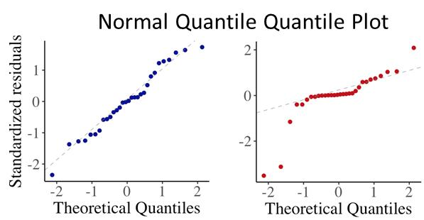
Detecting non-normality and unequal variance: Q-Q Plots, histograms of residuals

Slide 28
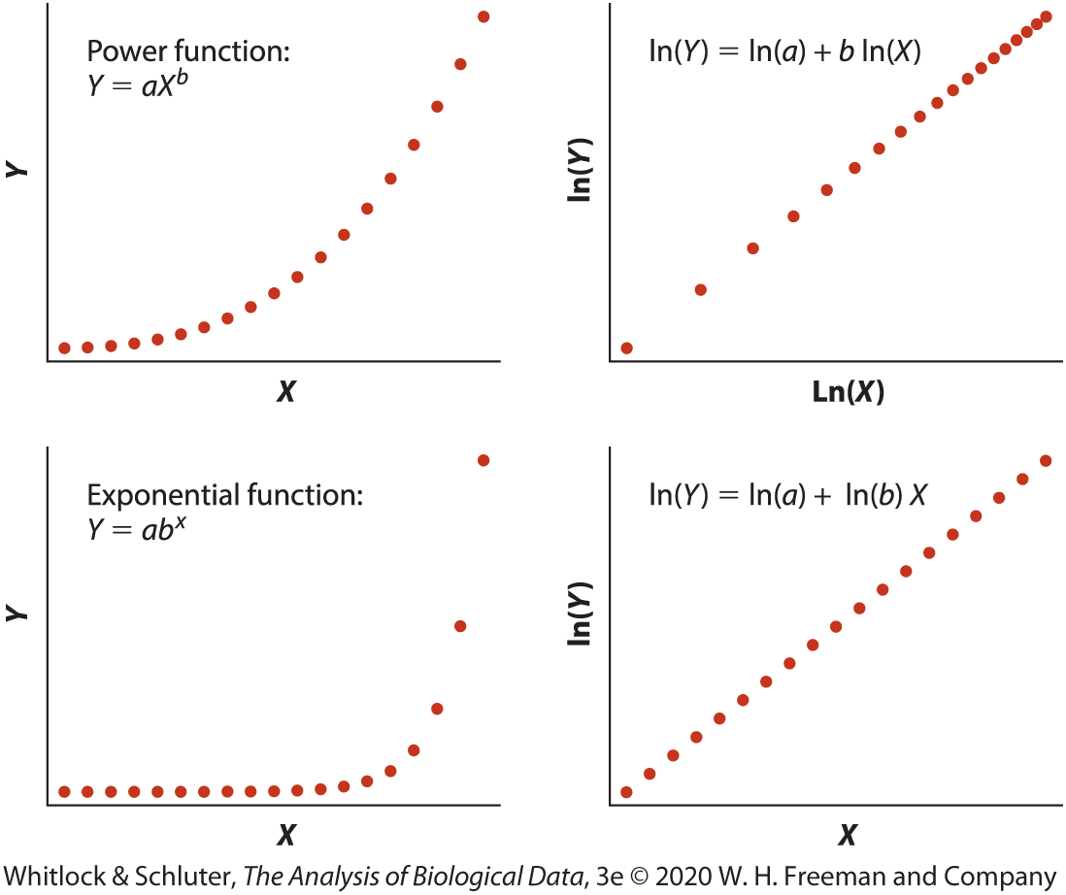
Log transformation to deal with non-linearity

Slide 29
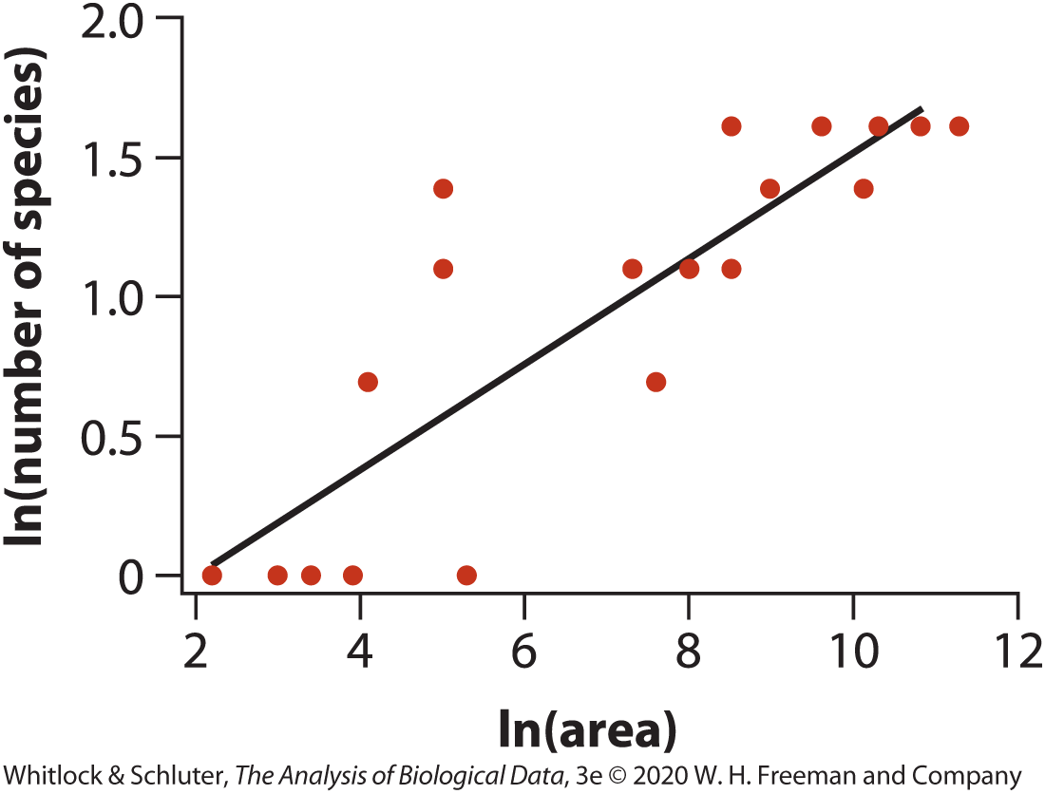
Log transformation to deal with non-linearity

Slide 30
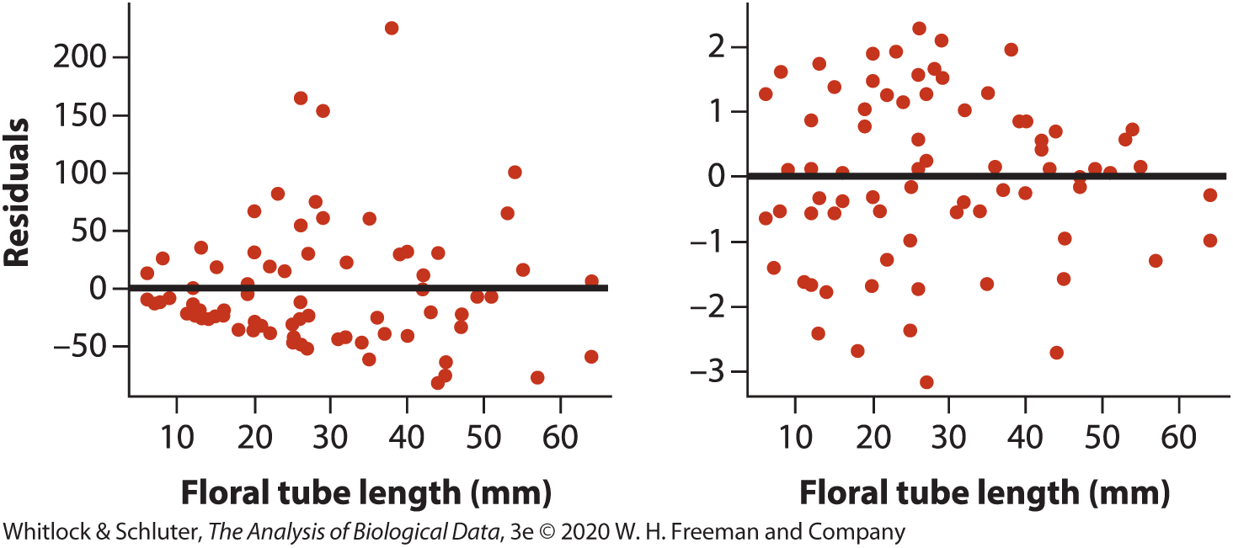
Transformation to deal with unequal variances
Notes:
Data are counts of pollen grains received by iris flowers with different floral tube lengths
Square root transformation helped in this case
Square root transformation often works for count data

Slide 31
Assumptions of regression
If the assumptions of linear regression are met, then a residual plot will have all of the following features except which one?
A symmetric, or nearly symmetric, cloud of points above and below zero along the range of X-values.
No obvious nonlinear pattern along the range of X-values.
Roughly the same variance of points above and below zero along the range of X-values.
The points will strictly alternate back and forth across the zero line.

Slide 32
Assumptions of regression (Answer)
If the assumptions of linear regression are met, then a residual plot will have all of the following features except which one?
A symmetric, or nearly symmetric, cloud of points above and below zero along the range of X-values.
No obvious nonlinear pattern along the range of X-values.
Roughly the same variance of points above and below zero along the range of X-values.
The points will strictly alternate back and forth across the zero line.
The correct answer is D.

Slide 33
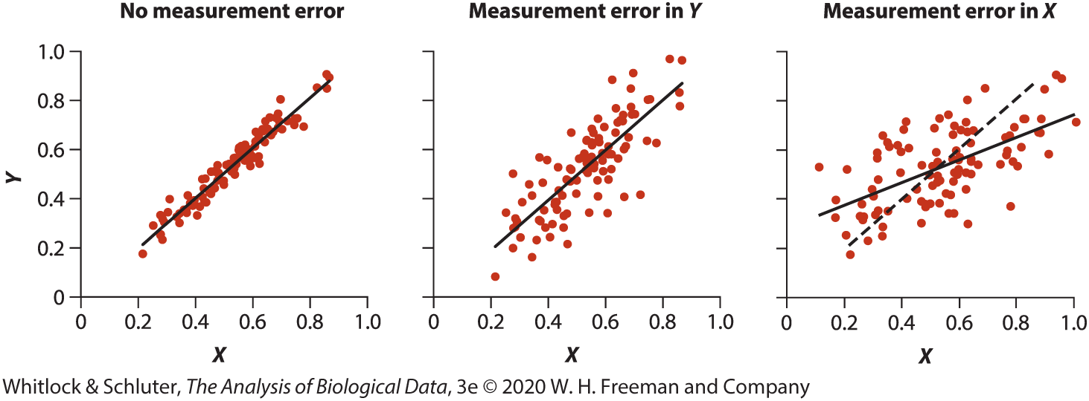
Effects of Measurement Error on Regression
Notes:
Measurement error in Y doesn’t have a huge effect on the slope
Measurement error on x does influence the slope

Slide 34
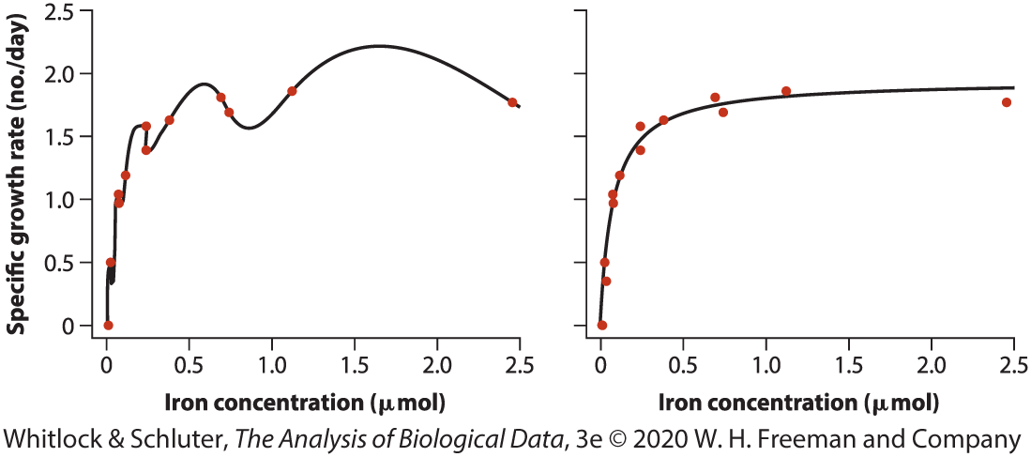
Things are not always linear!
Notes:
Left panel = polynomial regression, fits curve to every data point
Msresidual = 0
Right panel = Michaelis-Menten equation (biochemistry), much simpler curve
Simple is generally good

Slide 35
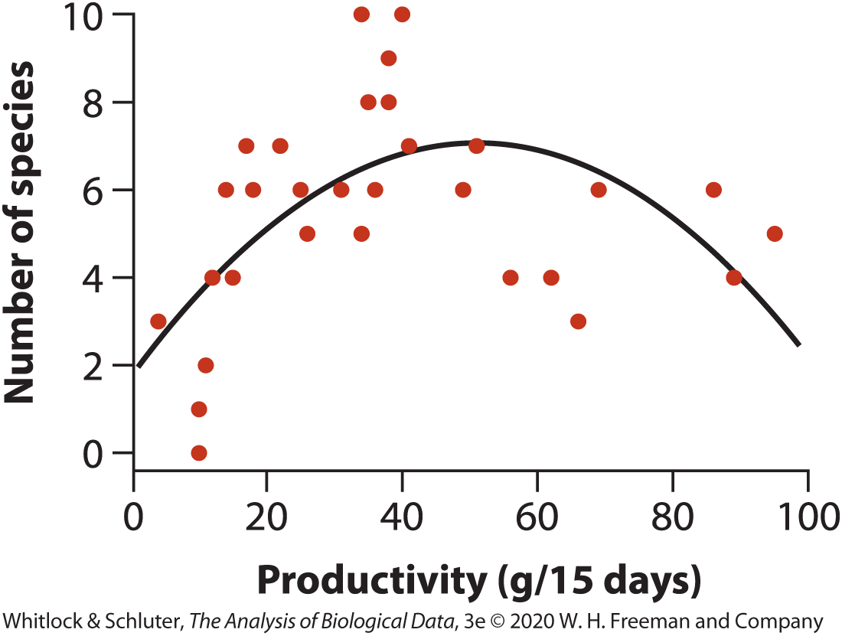
Quadratic curves
Y = a + bX + cX²
Notes:
Y = a + bX + cX^2

Slide 36
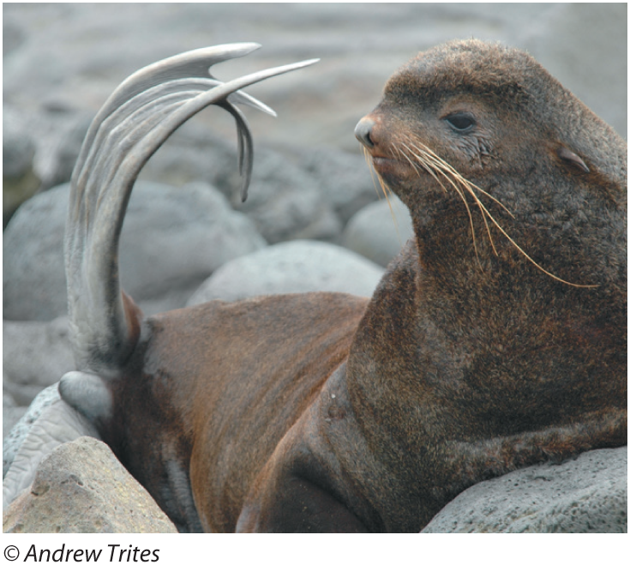
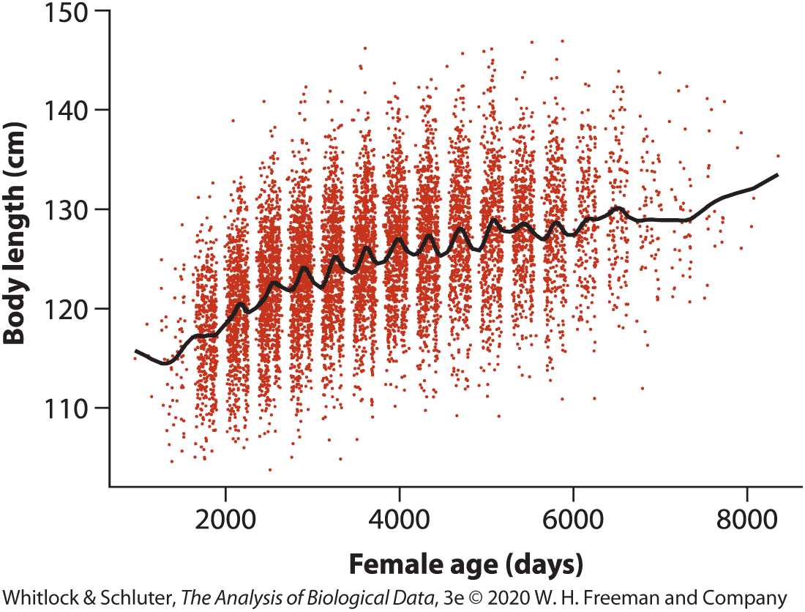
Formula-free curve fitting
Kernel, spline, loess smoothing (generalized additive models)
Notes:
Y = a + bX + cX^2

Slide 37
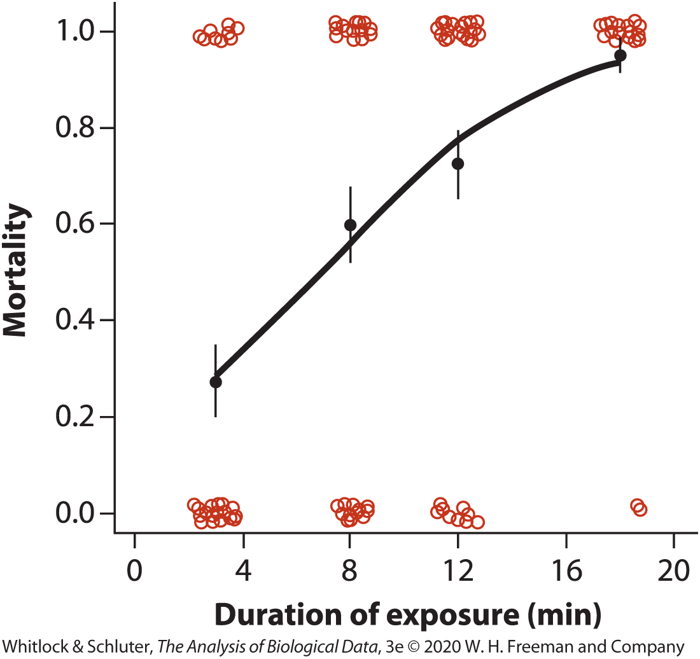
Logistic Regression
 | Duration of exposure (min): 3 | Duration of exposure (min): 8 | Duration of exposure (min): 12 | Duration of exposure (min): 18
Died (Y = 1) | 11 | 24 | 29 | 38
Survived (Y = 0) | 29 | 16 | 11 | 2
160 guppies exposed, 40 fish per treatment
Notes:
160 guppies exposed to cold temperatures for different durations
40 fish per treatment
Curve shows proportion of fish that die at levels of exposure X

Slide 38
Logistic Regression
Assumes outcomes at x have binomial distribution, instead of normal
Probability of an event (dying) for given x is predicted by curve
 | Estimate | SE
Intercept | −1.66 | 0.41
Slope | 0.24 | 0.04
Model | df | Deviance | Residual df | Residual deviance | P
Null |  |  | 159 | 209.55
Duration | 1 | 44.86 | 158 | 164.69 | 2.12×10⁻¹¹

Slide 39
Summary
Linear models predict Y as the intercept plus the slope times the value of X.
We can test the hypothesis of slope = 0 with the t-distribution or in an ANOVA framework.
Diagnostic plots allow for visual evaluation of assumptions that residuals should be normally distributed & independent of predictions.
Linear models can include polynomial terms!
Use logistic regression for binary response variables.

